Slide 1


Slide 2
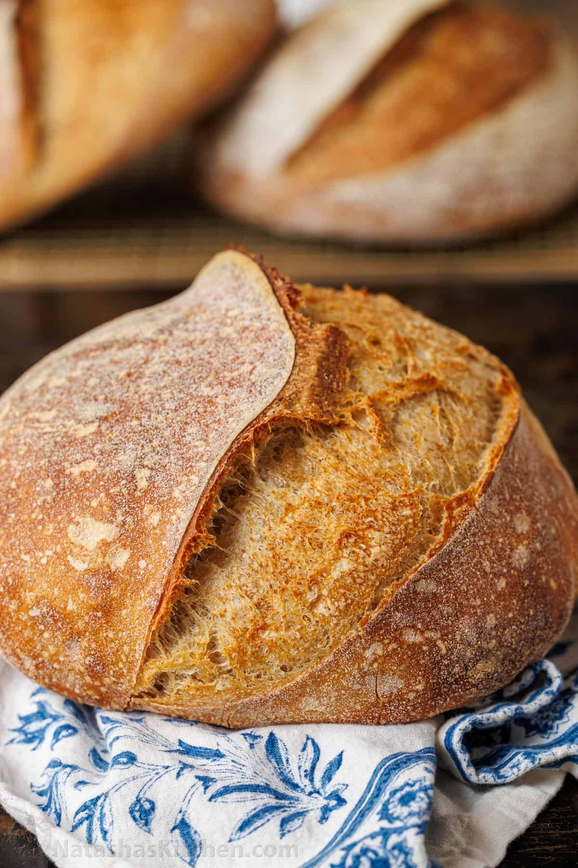

Slide 3


Slide 4


Slide 5


Slide 6
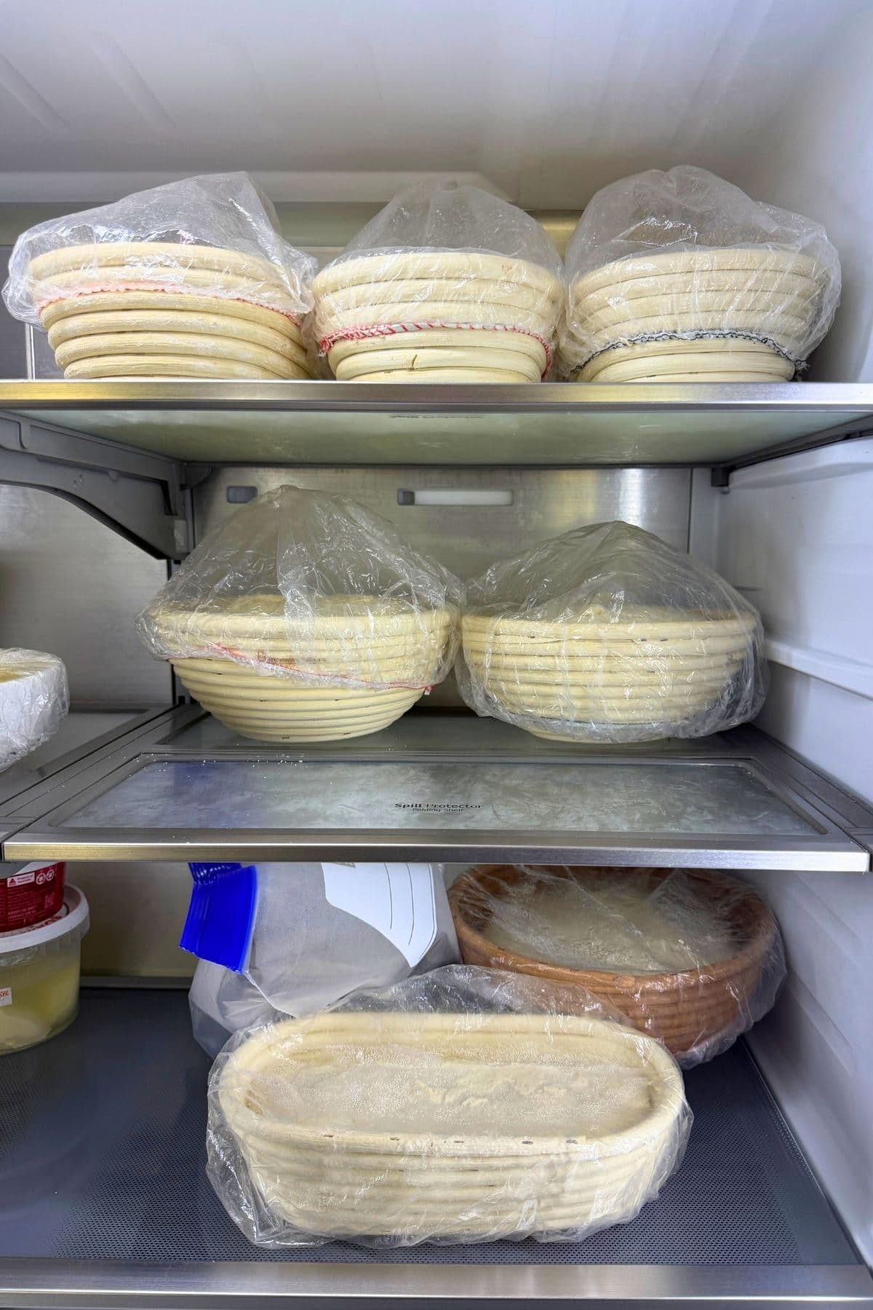

Slide 7
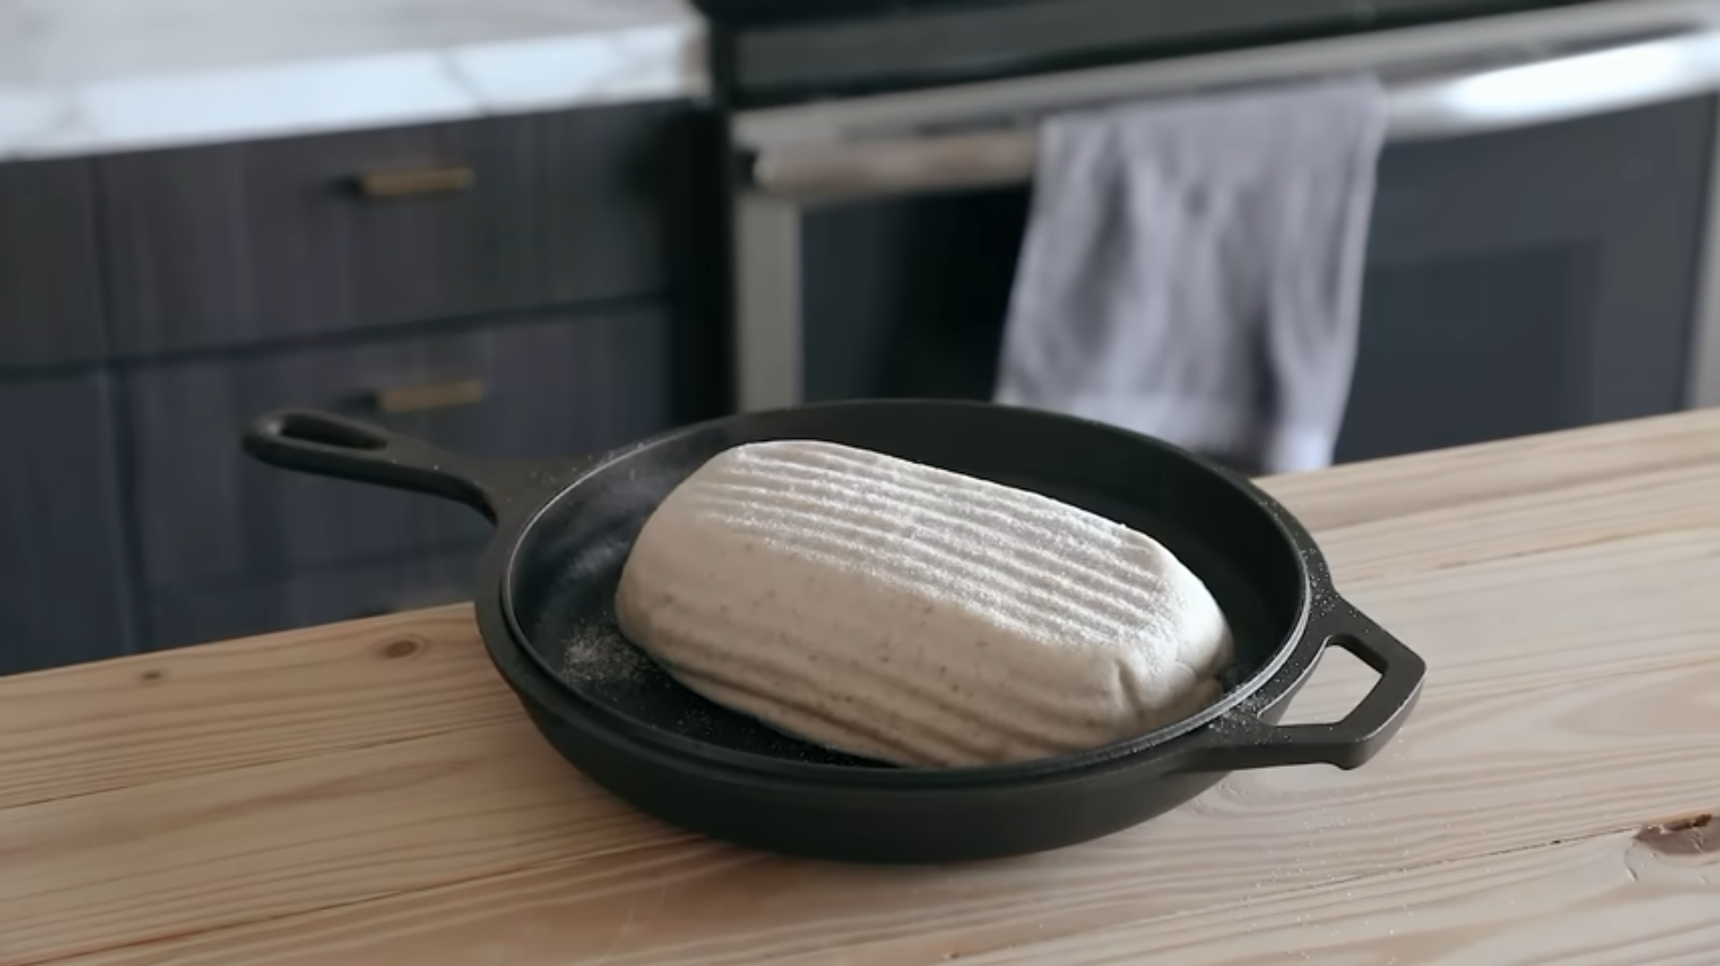

Slide 8
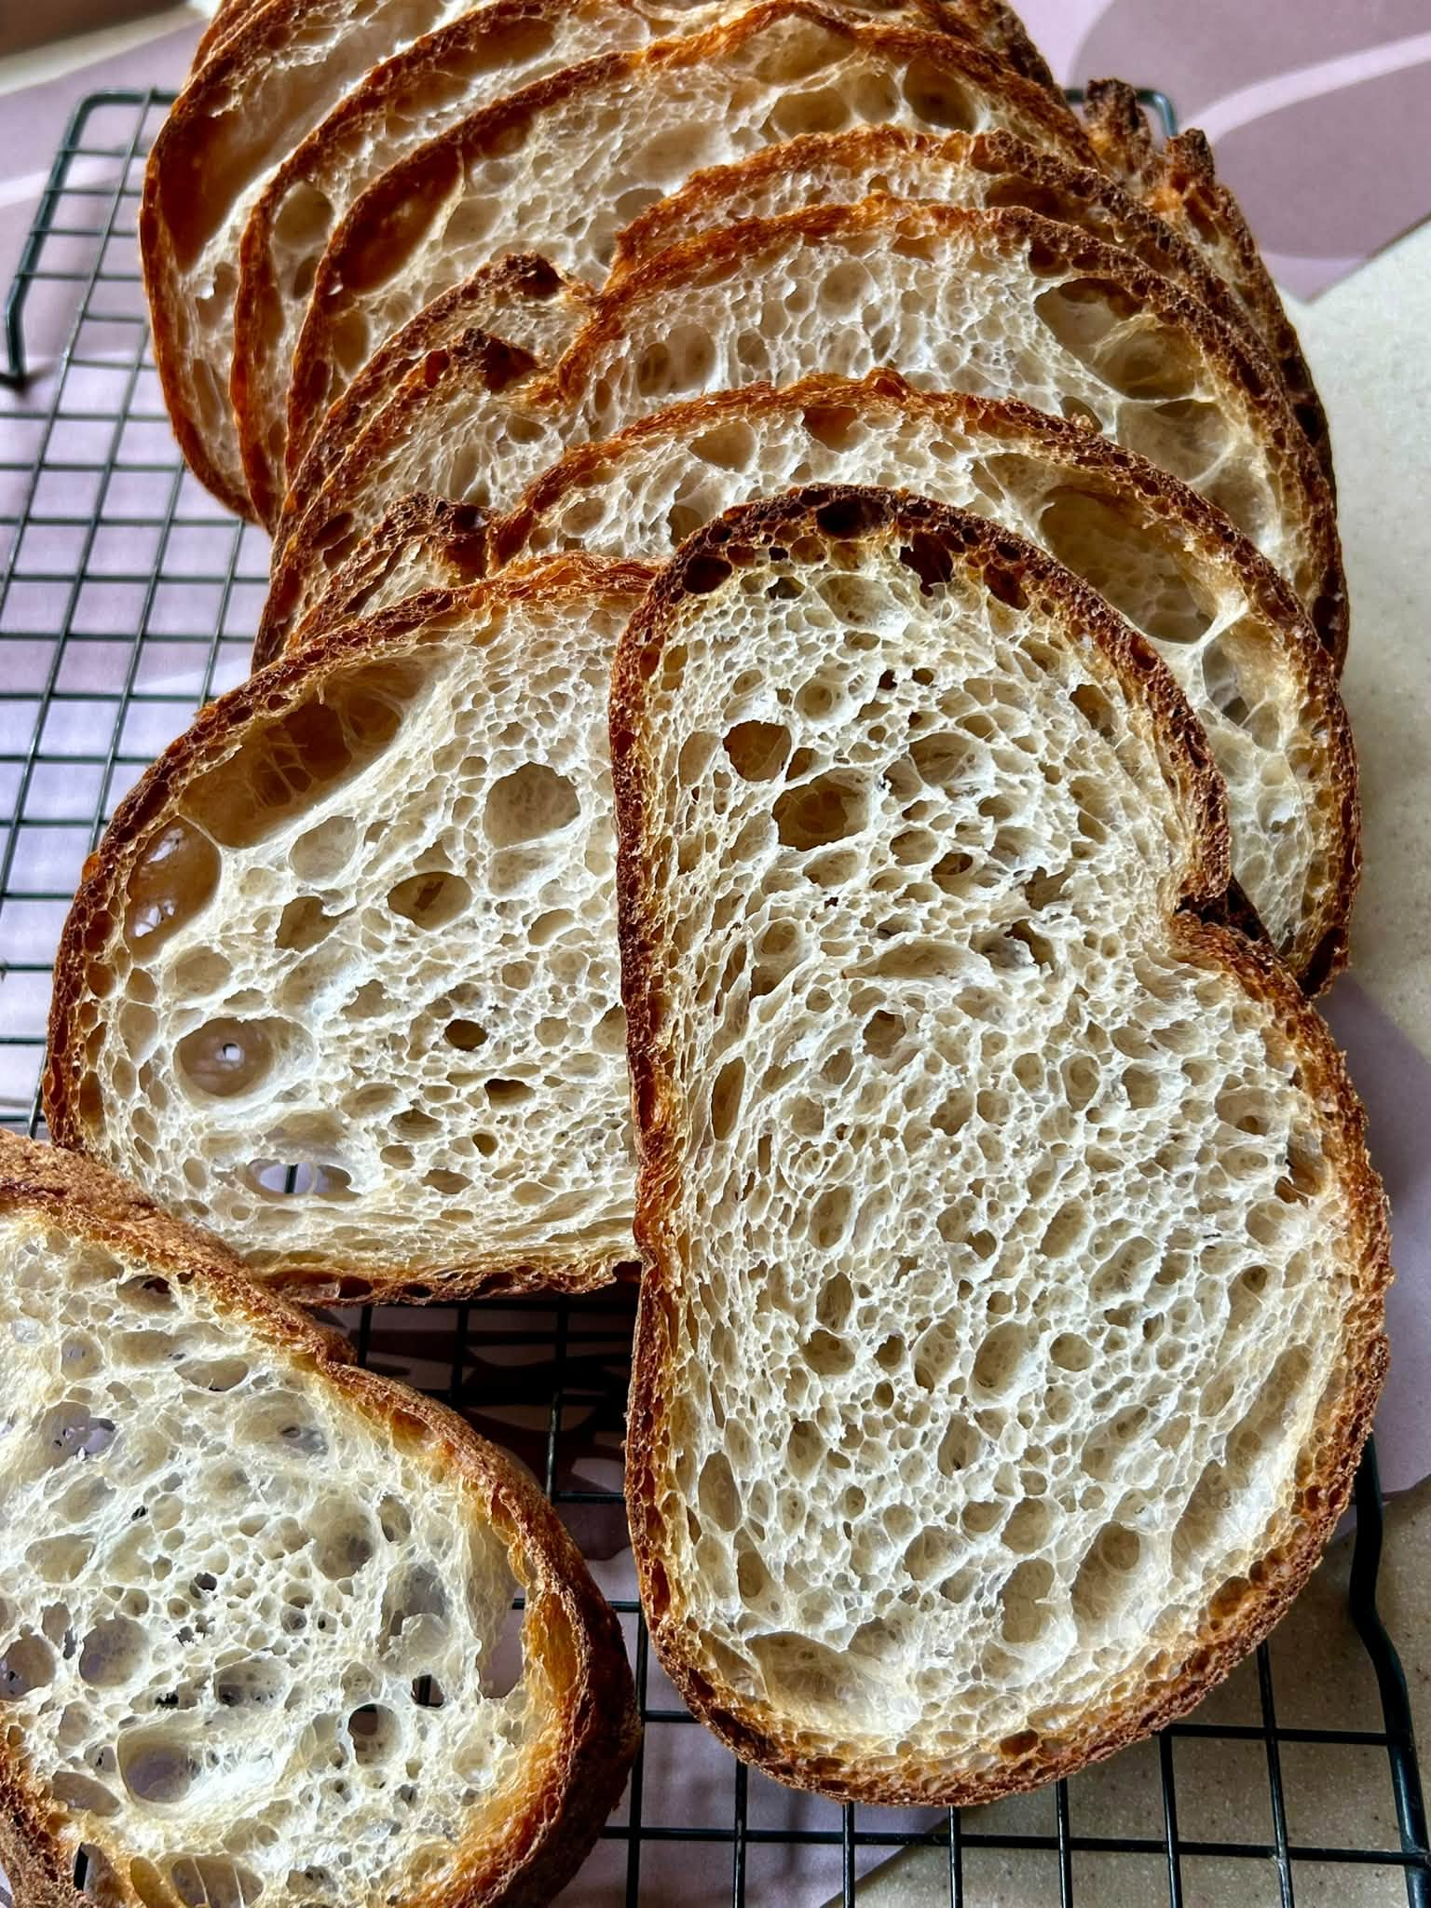

Slide 9
“Yet he is actually not far from each one of us, for ‘in him we live and move and have our being.’”
Acts 17:27-28

Slide 10
Q: How do I know God is involved in my life?

Slide 12
Genesis will help us understand…
God’s original plan for people
What went wrong/How sin entered the world
How God was faithful in providing a solution

Slide 13
GENESIS: Origin
The Hebrew title is Bereshit
meaning
“בְּרֵאשִׁית"

Slide 14
GENESIS: Origin
The Hebrew title is Bereshit
meaning
“In the beginning"

Slide 15
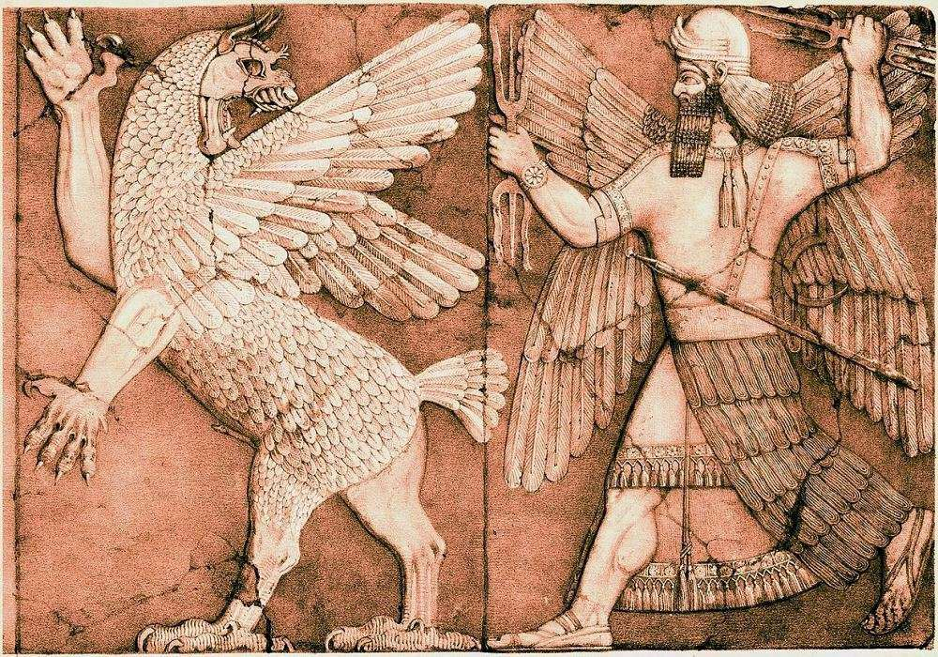

Slide 16
The earth was without form and void, and darkness was over the face of the deep. And the Spirit of God was hovering over the face of the waters.
Genesis 1:2

Slide 17
God said, “Let there be light,” and there was light.
Genesis 1:3

Slide 18
And God saw that the light was good.
Genesis 1:4

Slide 20
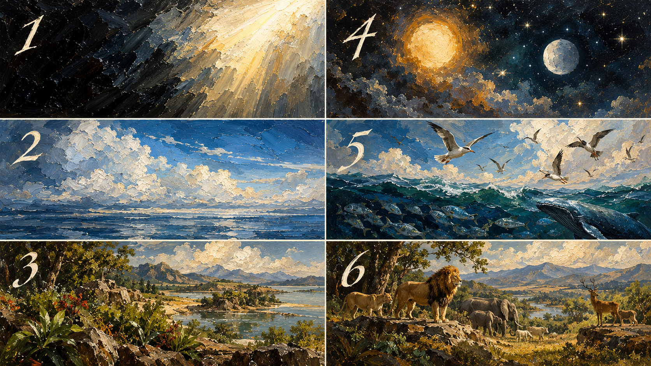

Slide 21
SUN, MOON, STARS
LIGHT
SKY, WATER
BIRDS, FISH
EARTH, PLANTS
ANIMALS, MAN

Slide 22
POP QUIZ:
Q: Who were the first to receive God’s blessing?
A.
PEOPLE
B.
The Stars in the sky
C.
The birds and the fish
Answer: C — The birds and the fish (Genesis 1:22).

Slide 23
And God blessed them, saying, “Be fruitful and multiply and fill the waters in the seas, and let birds multiply on the earth.”
Genesis 1:22

Slide 24
And God blessed them. And God said to them, “Be fruitful and multiply…”
Genesis 1:28

Slide 25
Not only does God create, but He also connects with us.

Slide 26
“So God created man in his own image,
in the image of God he created him;
male and female he created them.”
Genesis 1:27

Slide 27
God chose to have this special relationship with us, for that is the reason we were created.

